Slide 1
Care Aims
All Wales Diabetic foot
19TH - 20th October 2017

Slide 2
Increasing diabetic Population with rising amputation rates.
Complications account for 80% of expenditure. With estimated around £1 in every £150 which is spent by the NHS is consumed by the management of foot ulcers or amputations each year
Putting feet first pathway aims to direct patient care based on risk to ulceration
why you picked this service/area.
Pathway currently does not fit with Prudent Healthcare and is directive, with potential to increasing patients dependency on Healthcare and Podiatry provision.
What problem were you trying to solve?
Create a new pathway in line with Prudent Health Care Principles
Increase resilience and activation of patents to self manage own foot health
Resilient workforce
Free up capacity to see those with the greatest need - NDFA

Slide 3
Team/service
All Wales Diabetic Foot Network – Biannual Network meeting to adopt and share best practice - MDFT
Requested 4 representatives from each UHB – various levels of understanding of care aims.
28 attendees Podiatrist/orthotists/research Podiatrist
Example of Feedback:
‘provided an opportunity to reframe my thinking around clinical risk and rationale for ongoing management plans’
‘opened my eyes to the concept of dependency and how this can support caseload management’
‘Inspiring training, I feel better equipped to influence changes in clinical practice.’

Slide 4
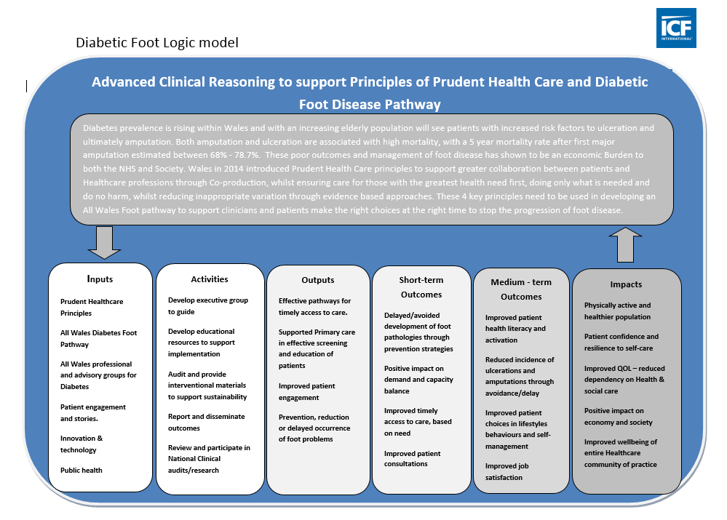
Challenges
What is a Logic Model?
Not a whole system approach
Across Wales different levels of understanding of care aims and will require further investment within the Health boards and Podiatry services to ensure whole system approach to changes

Slide 5
Outcome/Impact: Team
Advanced Collaborative, evidence based decision making for well being
Before After
understanding of the decision making process in relation to testing hypothesis 3.8- 7.1
understanding of the stages of duty of care 4.0 – 8.0
understanding of the concept of risk 4.7 – 7.6
understanding of the concept of clinical effectiveness 4.9 - 8.0
understanding of the concept of clinical need 5.5 – 8.6
understanding of the concept of dependency and how this can support caseload management 4.8 – 8.2
understanding of the factors influencing your ability to predict change 4.4 – 7.8
content of workshop 18/21 5:5 and 4/21 4:5
Facilitation of workshop 19/21 5:5 and 3/21 4:5

Slide 6
Cardiff and vale UHB Podiatry Service
July – Dec 2017
32 patients who had a consultation with a Podiatrist after attending a group educational programme were risk classified
as Moderate risk. 25 (78%) of these are supported to self care with access on how to access help when needed
and put on an annual recall. They are not offered regular routine appointments.
Previous model based on Putting Feet First Pathway would have seen them having one annual assessment plus up
to 4 treatments = Total Podiatry costs £344
New Model based Education and patient resilience = £143 approximately 58% per patient cost avoidance.
Based on potential Diabetes population of 3,400 if all seen as directed potential full costs = £1,169,600
New service model if all came under podiatry and all existing and new went through same programme
with 50:50 split on recall or dependent model = £682,000
Benefits:
Free up capacity to meet NDFA Recommendations
Resilient/activated patients
Reduction or delay of complications V2

Slide 7
Service Users

Slide 8
Next Steps:
What do you plan to do locally/would like to happen next strategically to take model forward?
Organisation sign up to influence direction
Local funding
Whole system approach
Support Network

